Slide 1
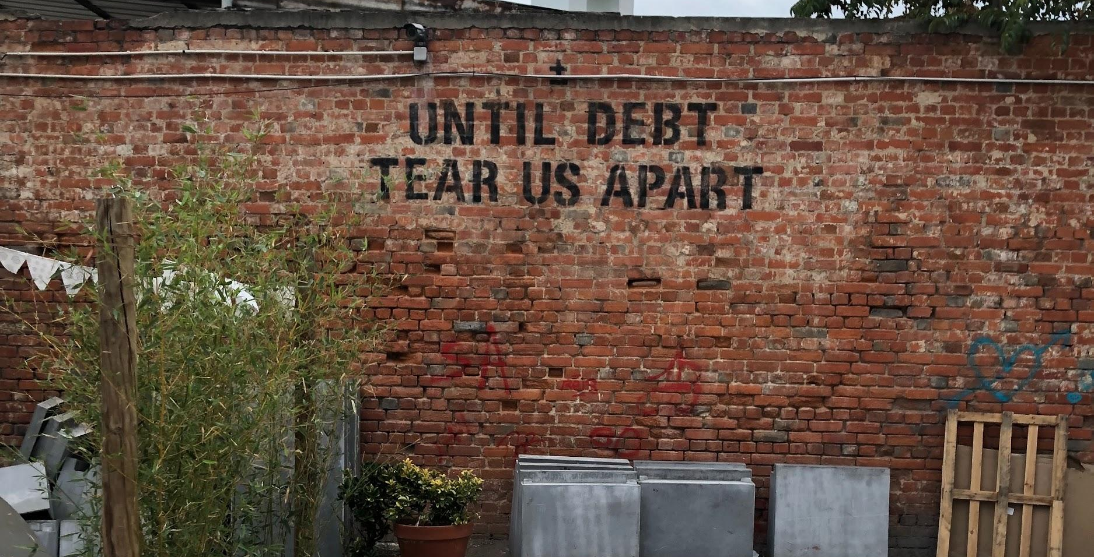
The Price of Education
Predicting the Level of Debt for Programs & Majors
Notes:
AJ

Slide 2

Presentation Agenda
Business Problem
01
Methodology
02
Results
03
Challenges
04
Next Steps
05
Limitations
06
Notes:
AJ

Slide 3


Student Debt is National Problem
Getting an education today in the US requires a much bigger sacrifice than it did for previous generations. In the past 30 years, public universities have tripled their attendance costs, and have private university costs have more than doubled.
11%
54%
Of student debt is past due/in default
Of College Attendees Take on Debt
Can Debt Forgiveness Save the Economy?
$1.4 Trillion
$35,359
Moody’s Investor Service predicts that eliminating the student debt owed could stimulate the economy as much as proposed tax cuts.
Outstanding Student Debt in 2019
Average Debt
per Borrower
Notes:
AJ

Slide 4
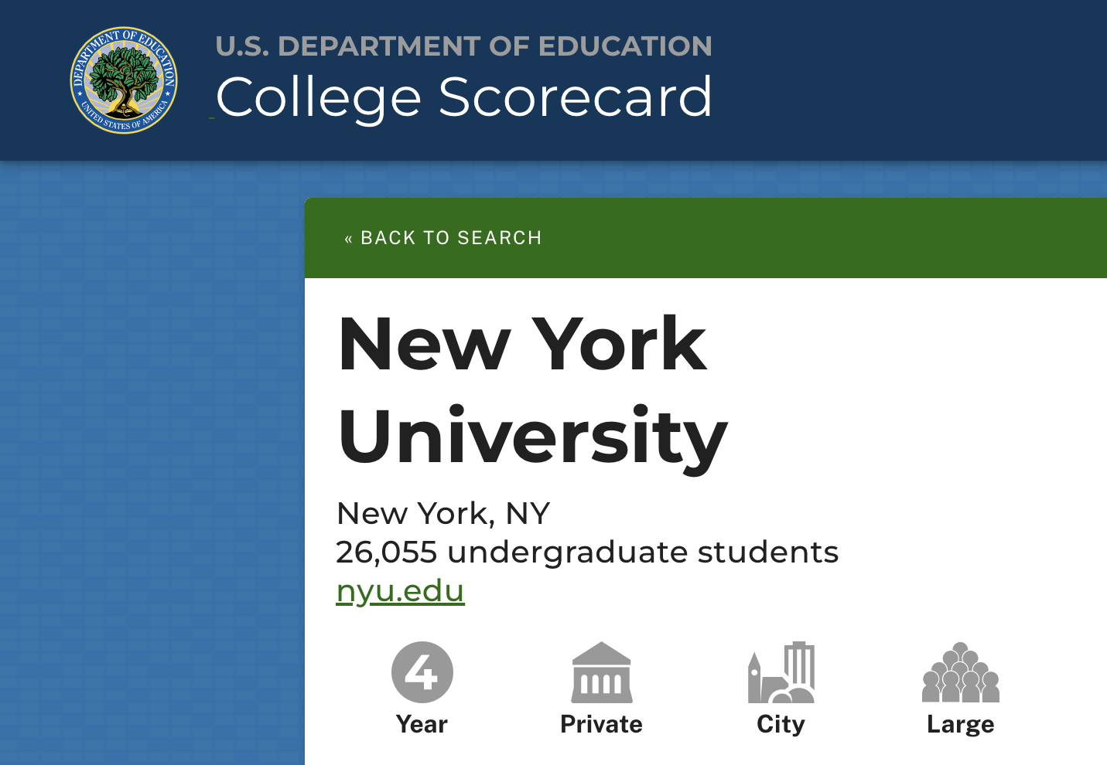
Our Data
7,793
1,977
22
Universities
Features
Years
We used the public College Scorecard database provided by the US Department of Education. This provides information on university costs of attendance as well as the financing needed to cover those costs.
Because of the age of the dataset, we were able to find the debt to income ratio of an average graduate of each university by dividing the average debt upon graduation by the average income a student made after 10 years, since most loans are 10-years on average.
Notes:
AJ
Discuss One Yr. vs.Full 22-yr data

Slide 5

Create more transparency on expected debt-to-income ratio at graduation before you attend.
Business Case:
Notes:
AJ

Slide 6
Technical Methodology
Data Preparation
Data Clean
Analysis
Evaluation
Three Data Divisions
Dropping Nulls
Criteria
Predictions
For-Profit
Non-Profit/Private
Non-Profit/Public
We dropped NaN values to scrub the one-hot-encoded dataset
Debt-to-Income Ratio
Demographic Breakdown
Tuition and Fees
Features of High Debt Institutions
DTI with GDP
Notes:
AJ

Slide 7
Data Exploration
Notes:
Charles (whole Data Exploration section)
Converting Privacy Suppressed to NaN
Dropping NaN values or columns with >5% NaN values
Created library to perform these basic operations

Slide 8
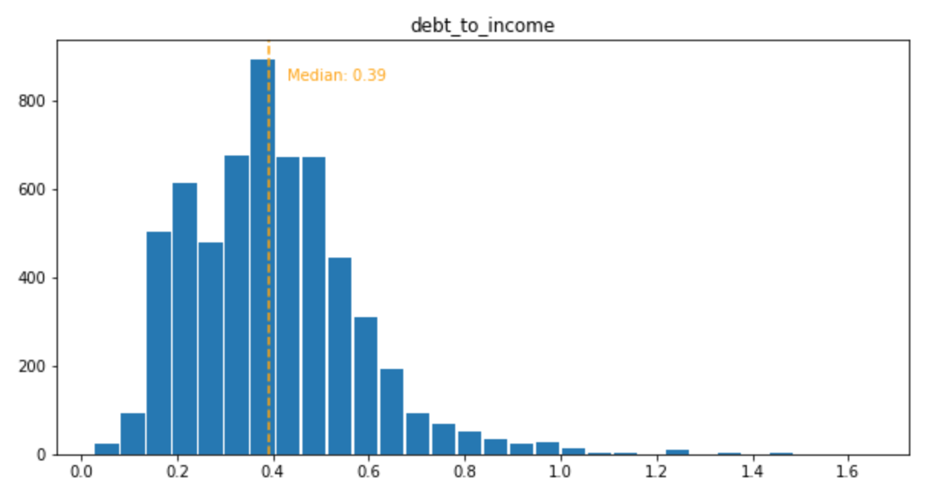
Debt-to-Income Ratio: All
Notes:
Charles
D-T-I for all schools

Slide 9
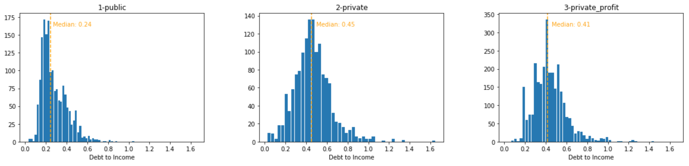
Debt-to-Income Ratio: School Type
Notes:
Charles
Talk about the mean
D-T-I for all schools broken out by region

Slide 10
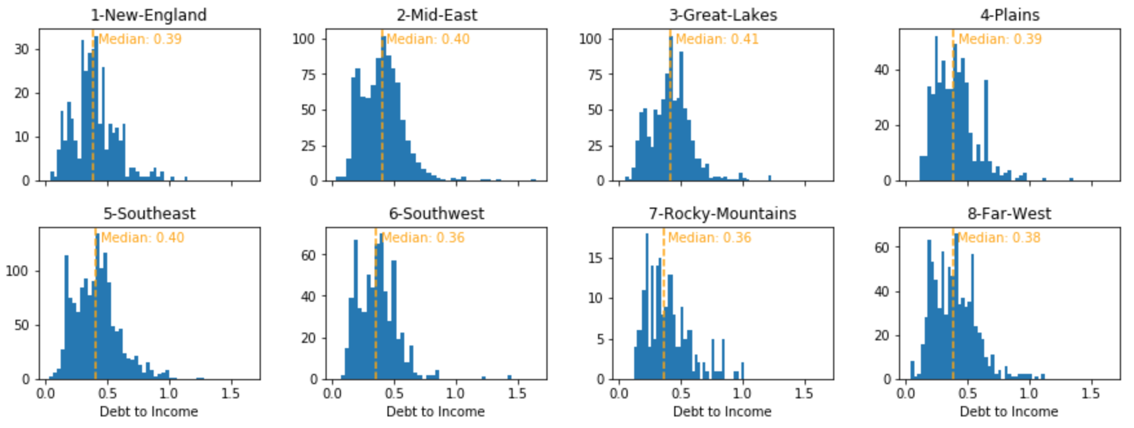
Debt-to-Income Ratio:
Geographical Breakdown
Notes:
Charles
# 0-U.S. Service Schools
# 1-New England (CT, ME, MA, NH, RI, VT)
# 2-Mid East (DE, DC, MD, NJ, NY, PA)
# 3-Great Lakes (IL, IN, MI, OH, WI)
# 4-Plains (IA, KS, MN, MO, NE, ND, SD)
# 5-Southeast (AL, AR, FL, GA, KY, LA, MS, NC, SC, TN, VA, WV)
# 6-Southwest (AZ, NM, OK, TX)
# 7-Rocky Mountains (CO, ID, MT, UT, WY)
# 8-Far West (AK, CA, HI, NV, OR, WA)
# 9-Outlying Areas (AS, FM, GU, MH, MP, PR, PW, VI)

Slide 11
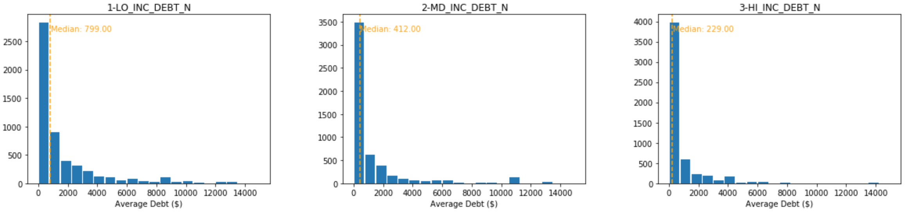
Debt-to-Income Ratio: Household Income
Notes:
Charles

Slide 12
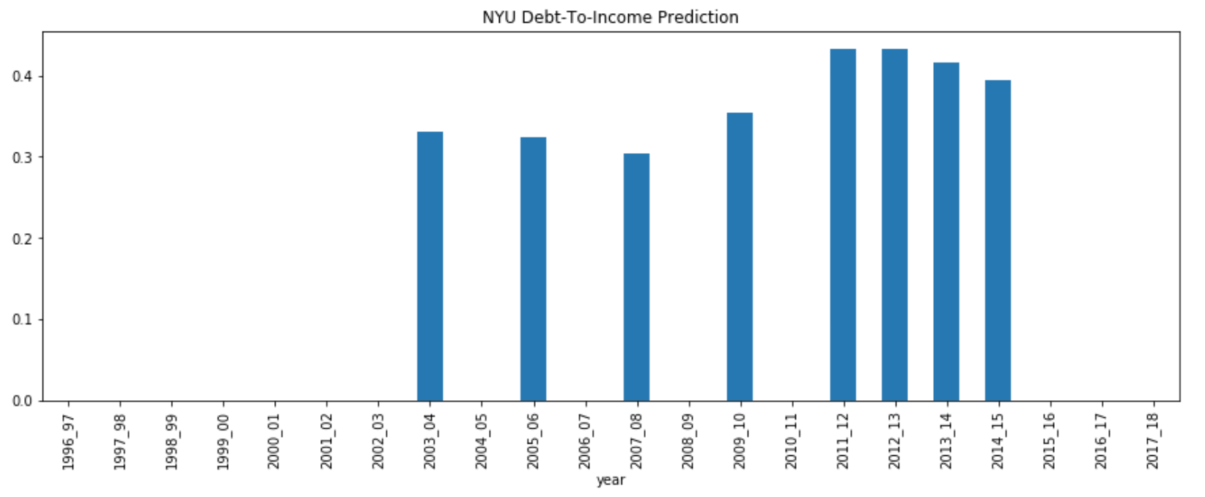
Debt-to-Income NYU
Notes:
Charles

Slide 13
Prediction Model
Notes:
Jenny

Slide 14
Modeling Techniques
K-Folds
Clustering
Selected training set of data to hold against smaller test set for decision tree model
Clustered debt-to-income ratio into two KMeans to find a guideline for establishing binary criteria
Box Plots
Decision Tree
Random Forest
Generated box plots to visualize any effect top features had on D-T-I
Examine different features and create binary nodes from comparing different entropy values across the features
Iterates over features to combine decision trees for D-T-I ratio and reveal top 20 predictive features.
Notes:
Jenny

Slide 15
Random Forest Accuracy
 | n=10 (avg ~8s) | n=100 (avg ~8s) | n=1000 (avg ~63s)
Public | 0.5985 | 0.7642 | 0.7736
Private | 0.5417 | 0.6814 | 0.6869
Private for Profit | 0.4058 | 0.6221 | 0.6349
*OOB Score uses out-of-bag samples to estimate the R^2 on unseen data
Notes:
Jenny
Noticed a significant difference between n=10 and n=100
We ran everything as n = 100

Slide 16
Random Forest
Public
Private
Private for Profit
SAT_AVG_ALL
RET_FT4
ADM_RATE_ALL
UGDS_BLACK
PPTUG_EF
PCIP50
TUITIONFEE_IN
ADM_RATE_ALL
PCIP23
RET_FT4
TUITIONFEE_IN
PCIP50
PPTUG_EF
CIPTFBS1
GRADS
Notes:
Charles
# Data from Random Forest
important_features_public = [
'SAT_AVG_ALL', 'RET_FT4', 'ADM_RATE_ALL', 'UGDS_BLACK', 'PPTUG_EF',
'TUITIONFEE_IN', 'UGDS_ASIAN', 'NPT4_PUB', 'PCIP50', 'UGDS_WHITE',
'COSTT4_A', 'UGDS_HISP', 'UG25ABV', 'UGDS_NHPI', 'TUITIONFEE_OUT',
'UGDS_AIAN', 'NPT45_PUB', 'PCIP14', 'NPT4_3075_PUB', 'GRADS'
]
important_features_private = [
'PCIP50', 'TUITIONFEE_IN', 'ADM_RATE_ALL', 'PCIP23', 'RET_FT4',
'PPTUG_EF', 'GRADS', 'UGDS_BLACK', 'NPT4_3075_PRIV', 'NPT42_PRIV',
'PFTFTUG1_EF', 'UG25ABV', 'UGDS_WHITE', 'PCIP52', 'UGDS_HISP',
'SAT_AVG_ALL', 'UGDS', 'NPT41_PRIV', 'PCIP51', 'D_PCTPELL_PCTFLOAN'
]
important_features_private_profit = [
'TUITIONFEE_IN', 'PCIP50', 'PPTUG_EF', 'CIPTFBS1', 'GRADS',
'UGDS_WOMEN', 'PFTFTUG1_EF', 'UG25ABV', 'UGDS_WHITE', 'TUITIONFEE_OUT',
'UGDS_HISP', 'UGDS_ASIAN', 'RET_FTL4', 'TUITIONFEE_PROG', 'UGDS_BLACK',
'MTHCMP1', 'UGDS', 'NUM4_PRIV', 'NUM42_PRIV', 'NUM41_PRIV'
]

Slide 17
Random Forest Important Features
Public
Private
Private for Profit
Average SAT equivalent score of students admitted for all campuses rolled up to the 6-digit OPE ID
First-time, full-time student retention rate at four-year institutions
Admission rate for all campuses rolled up to the 6-digit OPE ID
Total share of enrollment of undergraduate degree-seeking students who are black
Share of undergraduate, degree-/certificate-seeking students who are part-time
Percentage of degrees awarded in Visual And Performing Arts.
In-state tuition and fees
Admission rate for all campuses rolled up to the 6-digit OPE ID
Percentage of degrees awarded in English Language And Literature/Letters.
First-time, full-time student retention rate at four-year institutions
In-state tuition and fees
Percentage of degrees awarded in Visual And Performing Arts.
Share of undergraduate, degree-/certificate-seeking students who are part-time
Tuition, fees, books, and supply charges for largest program (full program)
Number of graduate students
Notes:
Jenny

Slide 18
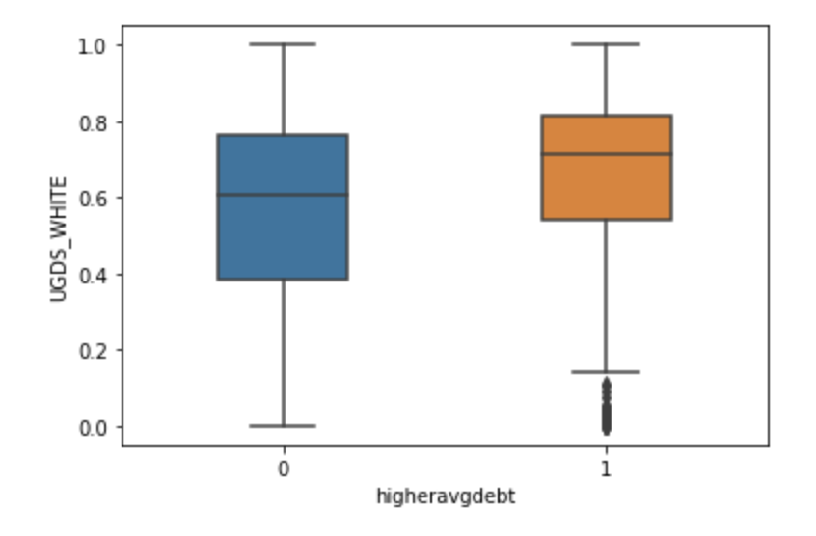
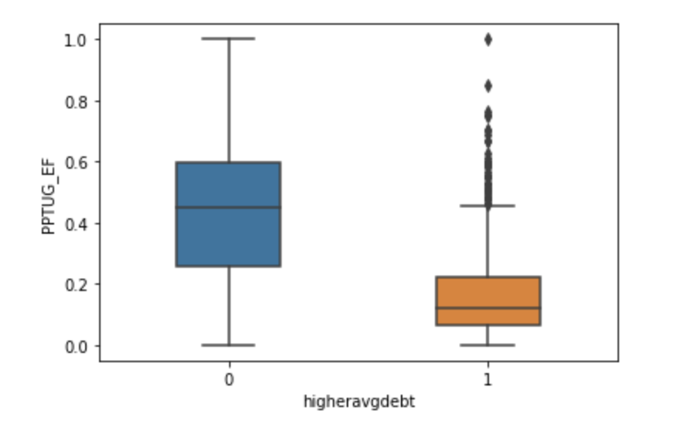
Box Plots
The percentage of white students seems to indicate that less diversity results in a slightly higher average distribution for debt.
Schools with a higher percentage of part time students show that they have a lower average debt than schools with 20% or less part time students
Notes:
Jenny
To create the box plots, we made the debt rate binary based on the average debt, on whether it was above or below. 0 represents below; 1 represents above.
As you can see demographic features are an important predictor of debt, where programs that are predominantly white have higher debt.
Part-time Studet

Slide 19
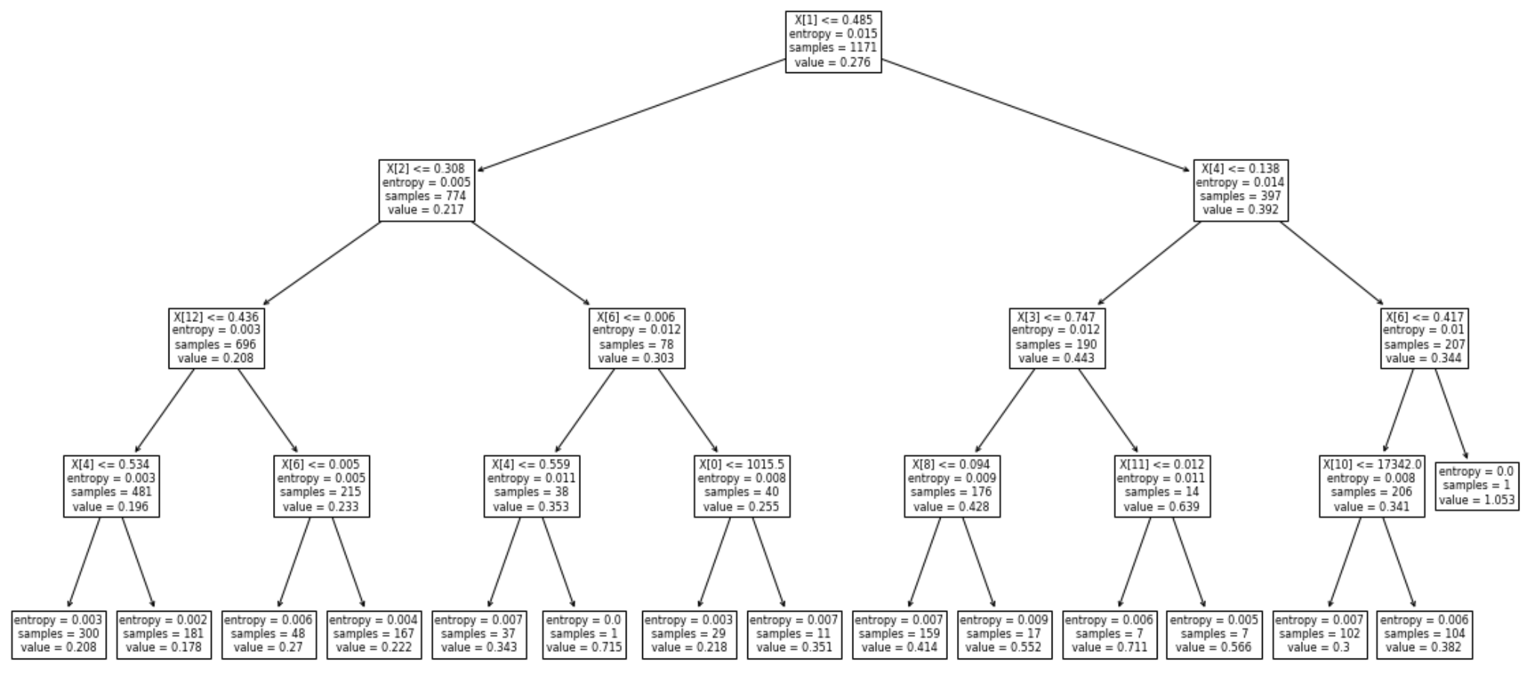
Decision Tree: Public School
Quality of Schools
Retention Rate 4-yr
Admission Rate
% of Part-Time
>25y.o Student
% Asian
% Black
% Asian
Notes:
Jenny
# Data from Random Forest
important_features_public = [
'SAT_AVG_ALL', 'RET_FT4', 'ADM_RATE_ALL', 'UGDS_BLACK', 'PPTUG_EF',
'TUITIONFEE_IN', 'UGDS_ASIAN', 'NPT4_PUB', 'PCIP50', 'UGDS_WHITE',
'COSTT4_A', 'UGDS_HISP', 'UG25ABV', 'UGDS_NHPI', 'TUITIONFEE_OUT',
'UGDS_AIAN', 'NPT45_PUB', 'PCIP14', 'NPT4_3075_PUB', 'GRADS'
]

Slide 20
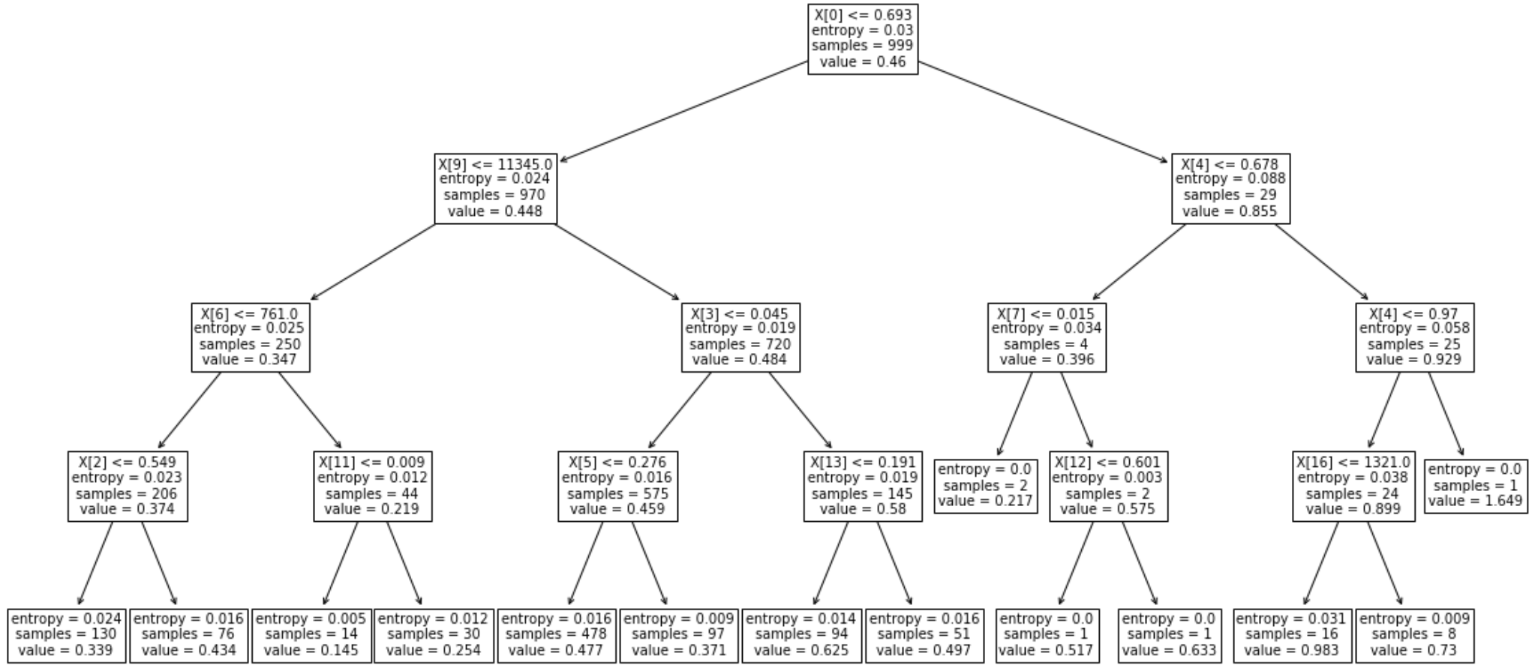
Decision Tree: Private School
Expected Income
Performing Arts
Net Price for $30-$48k income
Retention 4 yr
# of Grad Student
Admission Rate
% of Black
Retention 4 yr
Notes:
Jenny
important_features_private = [
'PCIP50', 'TUITIONFEE_IN', 'ADM_RATE_ALL', 'PCIP23', 'RET_FT4',
'PPTUG_EF', 'GRADS', 'UGDS_BLACK', 'NPT4_3075_PRIV', 'NPT42_PRIV',
'PFTFTUG1_EF', 'UG25ABV', 'UGDS_WHITE', 'PCIP52', 'UGDS_HISP',
'SAT_AVG_ALL', 'UGDS', 'NPT41_PRIV', 'PCIP51', 'D_PCTPELL_PCTFLOAN'
]

Slide 21
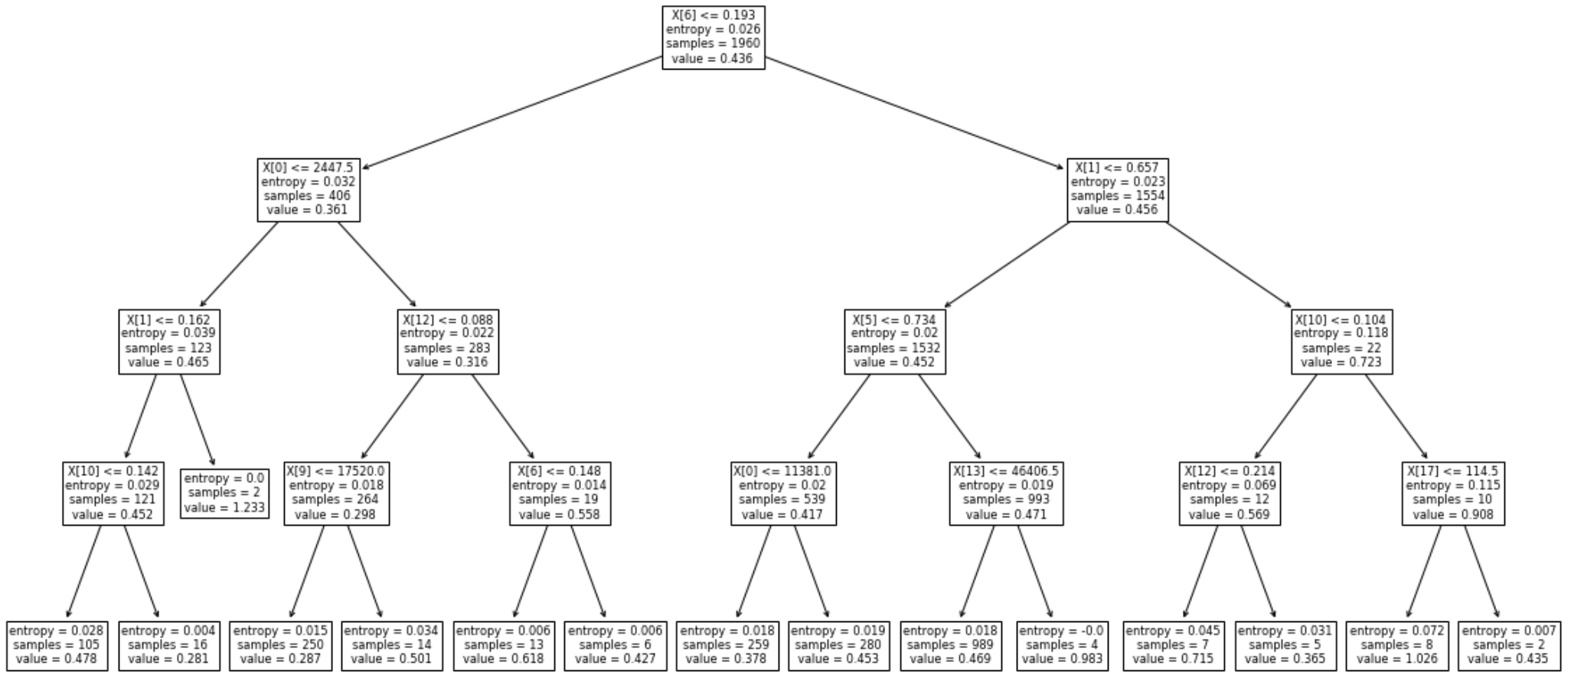
Decision Tree: Private School - For Profit
First time Undergrads
In-State Tuition
Performing Arts
Performing Arts
Retention Rate
% of female
% Hispanic
Notes:
Jenny
important_features_private_profit = [
'TUITIONFEE_IN', 'PCIP50', 'PPTUG_EF', 'CIPTFBS1', 'GRADS',
'UGDS_WOMEN', 'PFTFTUG1_EF', 'UG25ABV', 'UGDS_WHITE', 'TUITIONFEE_OUT',
'UGDS_HISP', 'UGDS_ASIAN', 'RET_FTL4', 'TUITIONFEE_PROG', 'UGDS_BLACK',
'MTHCMP1', 'UGDS', 'NUM4_PRIV', 'NUM42_PRIV', 'NUM41_PRIV'
]

Slide 22


Our Challenges
When dealing with such a large dataset with so many features, we had to determine which incomplete features to keep or delete for analysis and reference the dictionary to understand the insights our work revealed.
Technical
Business
Debt-to-income ratio was difficult to designate as a binary value for the box plots.
Decision Tree Rendering on a Windows Device was difficult to create.
Analyzing the significance of box plot and decision tree results amongst a diverse set of features.
Creating a narrative to fit into our business case was not a clear path.
Notes:
Jenny

Slide 23

Results
Consideration of Debt is Important when Deciding your Future Institution
Each School Type had differing features that better predicted the expected debt-to-income ratio.
Public schools’ D-T-I is heavily influenced by the program type, such as part-time and admission rate.
Private schools, both for- and non-profit schools, are influenced by expected income that a major would have, represented by % of Performing Arts majors.
Notes:
Charles

Slide 24
Debt-to-Income NYU
Notes:
Charles

Slide 25
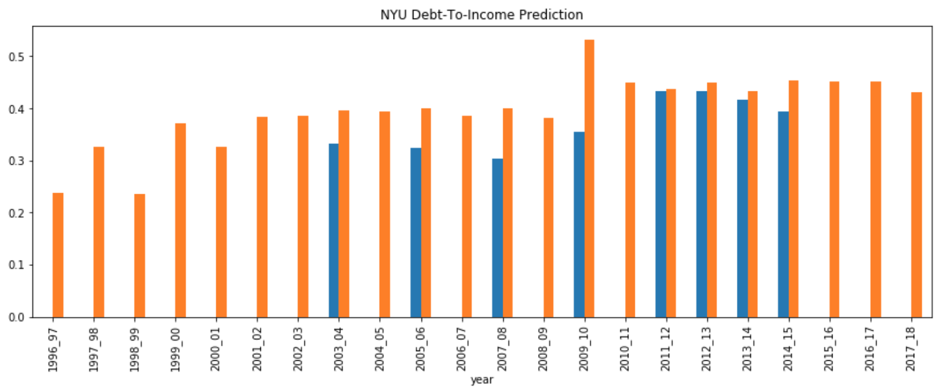
NYU: Predicting Debt-to-Income (Single Year)
Notes:
*Using prediction from model trained on 2013-2014 data only

Slide 26
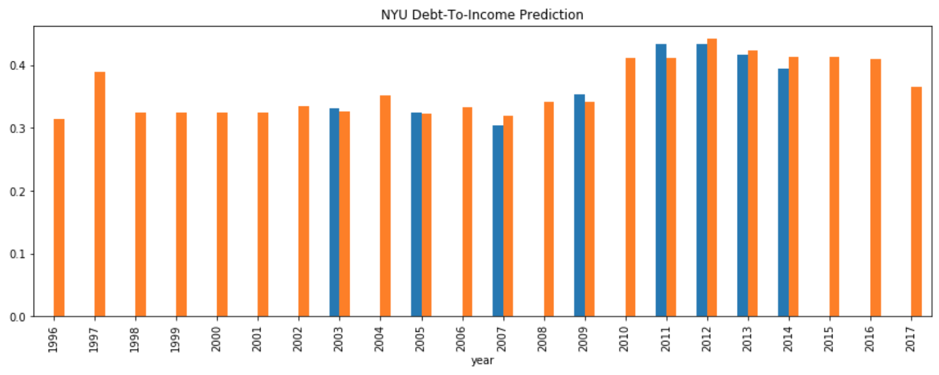
NYU: Predicting Debt-to-Income
(Full Data)
Notes:
Charles
*Using prediction from model trained on all years of data

Slide 27
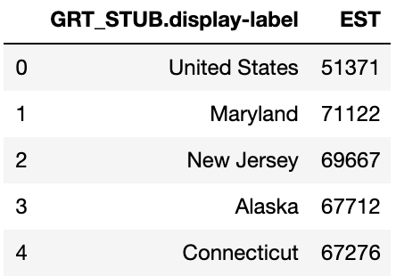
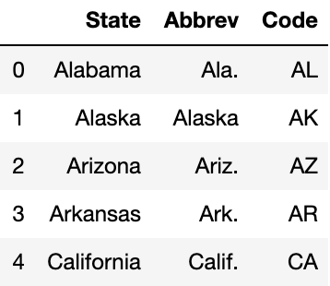
Predicting Debt-to-Income:
Single Year Adding External Data (Median Household Income)
Median Household Income
State Abbreviation
Soure: U.S. Census - MEDIAN HOUSEHOLD INCOME
Soure: World Population Review
Notes:
Charles

Slide 28
Predicting Debt-to-Income:
Single Year Adding External Data (Median Household Income)
OOB Score | Before External Data | After External Data | Percent Change
Public | 0.7303 | 0.7520 | 2.97%
Private | 0.5683 | 0.5628 | -0.97%
Private for Profit | 0.4766 | 0.4786 | 0.42%
*OOB Score uses out-of-bag samples to estimate the R^2 on unseen data
Notes:
Charles

Slide 29
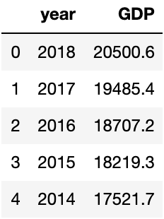
Predicting Debt-to-Income:
Full Year Adding External Data
(GDP)
U.S. GDP Data
Soure: Statista
Gross domestic product (GDP) of the United States from 1990 to 2018 (in billion current U.S. dollars )
Notes:
Charles
Statista:
Gross domestic product (GDP) of the United States from 1990 to 2018 (in billion current U.S. dollars )
https://www-statista-com.proxy.library.nyu.edu/statistics/188105/annual-gdp-of-the-united-states-since-1990/

Slide 30
Predicting Debt-to-Income:
Full Year Adding External Data
(GDP)
OOB Score | Before External Data | After External Data | Percent Change
Public | 0.7642 | 0.8779 | 14.88%
Private | 0.6814 | 0.8097 | 18.83%
Private for Profit | 0.6221 | 0.7780 | 25.06%
*OOB Score uses out-of-bag samples to estimate the R^2 on unseen data
*n=100 trees used
Notes:
Charles
*Using prediction from model trained on all years of data + GDP data

Slide 31
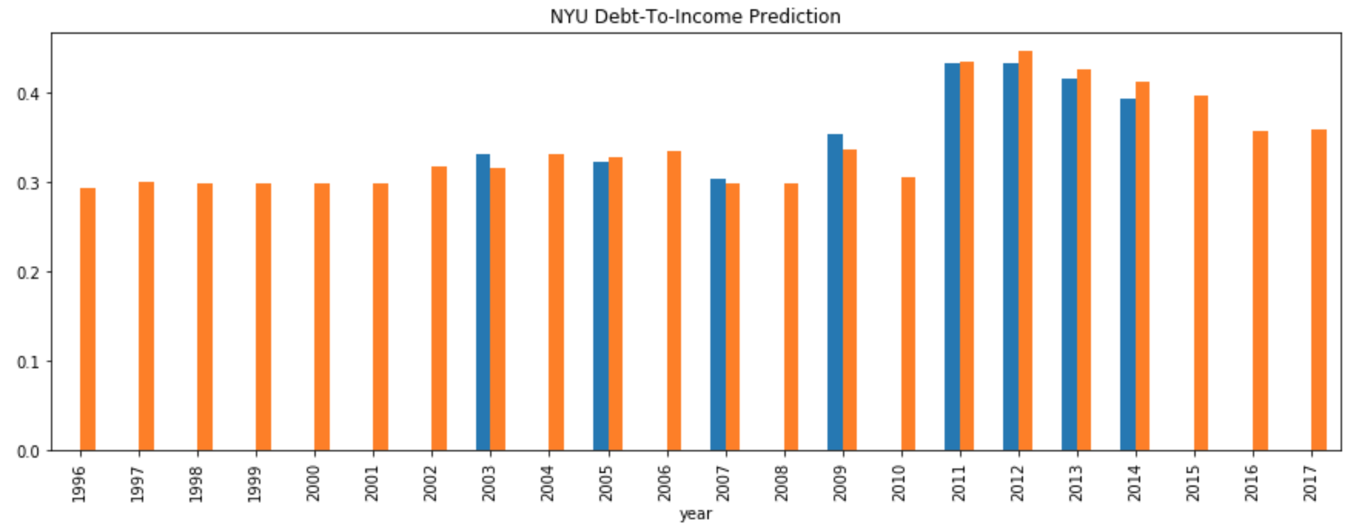
NYU: Predicting Debt-to-Income
(Full Data + GDP)
Notes:
Charles
*Using prediction from model trained on all years of data + GDP data

Slide 32

When choosing a university, consider…..
Debt-to-Income Predictors
Economic Health of the US
Competitiveness of the Program
Demographic Breakdown of the Program
Potential salary of your major
Notes:
AJ

Slide 33


Limitations
Granularity of Data
By University vs. Individual
By University vs. Schools/Program within a University
Size of Data
Notes:
AJ

Slide 34

Thank You
Any Questions?

